Slide 1


Slide 2


DeepTech System for Intelligent Energy Coordination in Distributed Microgrids
Pre-Final Year Project Synopsis
Submitted by
ROLL | NAME
2301730191 | ABHINAV KUMAR
2301730179 | ROHIT RAJ
2301730152 | NAMAN JOSHI
23021730141 | ADITYA SUMAN
Faculty Mentor: Ms. Suman
Notes:
New Courses replaced with New Programmes

Slide 3

Project Overview
Rethinking Microgrid Coordination
Decentralized Agentic Framework: Transitions from a traditional central controller to a multi-agent system where microgrids act as autonomous "Prosumers," negotiating energy trades in a P2P marketplace.
Dual-Layer Intelligence Model: Decouples high-level strategic reasoning from physical execution.
Strategic Layer: LLM-powered agents for market negotiation, planning and user interaction.
Tactical Layer: Event-driven MQTT Orchestrators for zero-latency safety and control.
Advanced Predictive Analytics: Integrates LSTM and XGBoost forecasting for load and generation, enabling agents to proactively schedule resources instead of reacting to current states.
N-1 Resiliency & Safety: Implements a mandatory 10% critical energy buffer within the low-level orchestrator to ensure immediate power availability during grid failover or "decision lag".
Privacy-by-Design: Edge Intelligence with local Private SQLite databases, ensures granular usage data remains in the home.
System Impact: Designed for collaborative communities to maximize renewable self-consumption and significantly reduce operational costs.
Notes:
New Courses replaced with New Programmes

Slide 4
Specific Objectives
Autonomous Peer-to-Peer Trading: To implement a decentralized marketplace where LLM-powered agents negotiate energy trades autonomously based on local surplus and community demand.
Dual-Layered Real-Time Control: To develop a coordination logic that separates high-level strategic reasoning (LLMs) from sub-second physical actuation (MQTT Orchestrators).
N-1 Resiliency & Safety Buffer: To enforce a mandatory 10% critical energy reserve and automated grid-failover protocols to ensure power continuity during "decision lag" or grid outages.
High-Accuracy Forecasting: To achieve a 15–20% improvement in resource scheduling by integrating XGBoost/LSTM models for individual household consumption and solar generation.
Privacy-Preserving Edge Intelligence: To design a data layer that keeps granular usage telemetry within local Private SQLite databases, sharing only high-level intents for market coordination.
Sustainability & Cost Optimization: Enables sustainable microgrid system with cost optimization for every node.
Notes:
New Courses replaced with New Programmes

Slide 5
Key Features
Agentic Strategic Reasoning: Autonomous LLM-powered "brains" that handle high-level economic negotiation and long-term trading strategy.
Zero-Latency MQTT Orchestrator: An event-driven tactical governor for sub-second hardware switching and deterministic safety enforcement.
Mandatory 10% Safety Buffer: A proactive energy reserve that ensures N-1 resiliency and power continuity during "decision lag" or sudden demand spikes.
Privacy-Preserving Edge Data: A hybrid storage architecture using Private SQLite (local telemetry) and PostgreSQL (public marketplace metadata).
Predictive Foresight Engine: Integrated XGBoost and LSTM models for high-accuracy, 24-hour demand and renewable generation forecasting.
Autonomous Grid Failover: Seamless, sub-millisecond transitions between P2P trading, grid connectivity, and local storage to prevent blackouts.
Notes:
New Courses replaced with New Programmes

Slide 6
Project Use Cases & Scope
Target Use Cases
Campus Microgrid Clusters: Hostels, academic blocks, and labs exchanging energy via LLM agents to reduce campus-wide diesel usage and grid imports.
Prosumer Industrial Estates: Coordinated operation of process loads, rooftop PV, and shared battery storage to lower peak demand charges and maximize self-consumption.
Utility Grid Support: Providing ancillary services like frequency support and black-start capability to the main distribution company during regional instabilities.
Project Scope
Intelligence Layer: Developing high-level LLM agents for autonomous P2P negotiation and XGBoost/LSTM models for 24h predictive forecasting.
Control Layer: Implementing a sub-second MQTT-based "Orchestrator" with a mandatory 10% safety buffer for N-1 hardware resiliency.
Data Layer: Designing a hybrid privacy-centric architecture (Edge-based SQLite and centralized PostgreSQL marketplace).
Simulation Environment: A functional prototype simulating 3–5 interconnected microgrid nodes (focusing on EMS software logic, not hardware fabrication).
Notes:
New Courses replaced with New Programmes

Slide 7
Prototype/Project Flow diagram/Architecture
Edge Data Layer (Privacy-First): Ingests real-time telemetry (Voltage, Current, SoC) via MQTT into local Private SQLite databases. This ensures "Privacy-by-Design," as granular sensor data remains strictly at the node, preventing the exposure of household occupancy patterns to the cloud.
Tactical Orchestrator (Safety Governor): A deterministic controller that serves as the system's "Fast-Lane." It enforces the 10% critical energy buffer and executes sub-second hardware switching. This layer ensures N-1 resiliency by managing instant grid-failover if the LLM's strategic "decision lag" exceeds physical safety windows.
Strategic LLM Agent (Reasoning Layer): Operates in the "Slow-Lane," processing LSTM/XGBoost forecasts and market trends. It utilizes Large Language Models to reason through complex economic trade-offs—such as battery health vs. arbitrage profit—issuing strategic directives via structured JSON commands.
Central Marketplace (Anonymized Hub): A PostgreSQL-based "Bulletin Board" where agents post high-level energy surplus/deficit "intents." It facilitates peer discovery and trade settlement without requiring nodes to share sensitive, raw telemetry, optimizing the community-wide energy balance.
Dual-Loop Feedback Synchronization: Establishes a continuous handshake between high-level reasoning and low-level execution. The Orchestrator provides the LLM with "Safe Operating Windows," while the LLM provides the Orchestrator with "Economic Setpoints," ensuring a stable yet profitable microgrid ecosystem.
Notes:
New Courses replaced with New Programmes

Slide 8
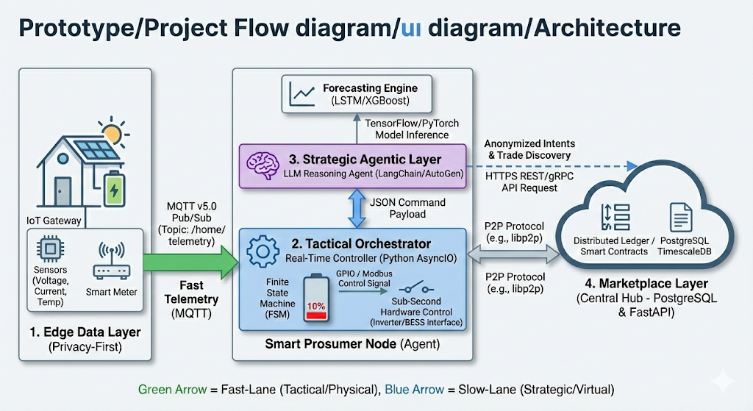
Prototype/Project Flow diagram/Architecture
Notes:
New Courses replaced with New Programmes

Slide 9
Data & Resources
Data Sources
Kaggle Dataset: High-resolution (15-min) load data for demand modeling.
Environmental Telemetry: Real-time solar irradiance and temperature via weather APIs.
Software & Intelligence Stack
AI Frameworks: PyTorch for forecasting, FSM for orchestration and LLM for reasoning.
Communication: MQTT (Mosquitto) for low-latency, event-driven control signaling.
Hybrid Databases: Local SQLite (Privacy-first) and Centralized PostgreSQL (Marketplace).
Backend Logic: FastAPI for asynchronous P2P trade discovery and settlement.
Prototyping & Simulation
Power System Emulators: Pandapower and Simulink for high-fidelity electrical modeling.
System Scale: Orchestrated framework simulating a 5-10 node microgrid homes.
Notes:
New Courses replaced with New Programmes

Slide 10
Methodology
Methodology & Implementation Roadmap
Phase 1: Edge & Data Setup
Establishing the MQTT backbone and local SQLite nodes for privacy-centric telemetry.
Phase 2: Predictive Engine Training
Developing LSTM and XGBoost models for high-accuracy 24h demand and solar forecasting.
Phase 3: Tactical Orchestrator Logic
Coding the deterministic safety governor to enforce the 10% critical buffer and failover.
Phase 4: Strategic Agentic Marketplace
Integrating LLM-based P2P negotiation and a centralized PostgreSQL hub for trade settlement.
Phase 5: Simulation & KPI Validation
Deploying a 3–5 node Docker cluster to evaluate resiliency, cost savings, and renewable utilization.
Notes:
New Courses replaced with New Programmes

Slide 11
Expected Results & Impact
Expected Results & Impact
Optimized Renewable Utilization: Achieving renewable self-consumption by synchronizing agentic P2P trades with peak solar generation windows.
Economic Cost Reduction: Targeted reduction in community energy expenditure through intelligent arbitrage and peak-shaving strategies.
Enhanced System Reliability: Seamless sub-second failover and zero downtime during local grid outages, guaranteed by the mandatory 10% safety buffer.
High-Accuracy Forecasting: Significant improvement in predictive performance, targeting a low Mean Absolute Percentage Error (MAPE) for load and generation.
Privacy-Preserving Intelligence: Demonstration of a zero-leakage edge architecture, ensuring sensitive household telemetry never leaves the local node.
Sustainability & Scalability: A reduction in community carbon footprint and a proven software blueprint for autonomous, decentralized smart city energy networks.
Notes:
New Courses replaced with New Programmes

Slide 12
Project Timeline
Project Timeline & Milestones
Month 1: System Design & Data Acquisition
Literature review, architecture finalization, and preprocessing of smart meter/weather datasets.
Month 2: Infrastructure & Predictive Modeling
Deployment of MQTT/SQLite backbone and training of LSTM/XGBoost forecasting engines.
Month 3: Agent Logic & Market Integration
Development of the Tactical Orchestrator and LLM negotiation agents with a PostgreSQL hub.
Month 4: Simulation, Testing & Evaluation
3–5 node Docker simulation, N-1 resiliency stress testing, and final KPI performance analysis.
Notes:
New Courses replaced with New Programmes

Slide 13
THANK YOU

